Slide 1
Wireless Power Monitoring Device (Arduino and Communications Programming)
Project Progress Report
11/26/2012
Report by: Ka Fung

Slide 2
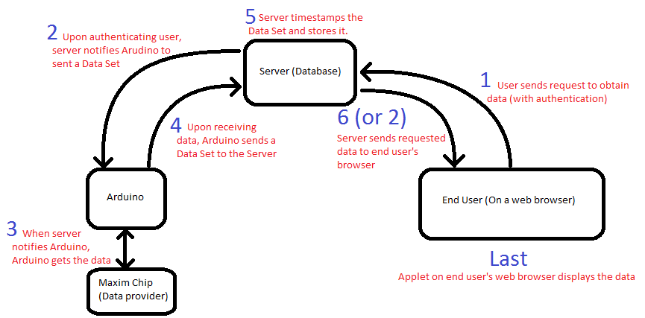
Operations Overview

Slide 3
Sample Data Set
Freq: 59.984
VoltA: 120.802 VoltB: 120.845 VoltC: 120.853
CurrA: 2.099 CurrB: 2.143 CurrC: 2.145 CurrN: 10.396
RealA: 14.612 RealB: 14.907 RealC: 14.945
ReacA: -20.730 ReacB: -21.179 ReacC: -21.183
AppaA: 25.441 AppaB: 25.916 AppaC: 26.041
PFA: 0.576 PFB: 0.578 PFC: 0.577 PFT: 0.000
PhaseAB: 359.870 PhaseAC: 359.840
THDA: 136.192
CHA1: 1.247 CHA2: 0.057 CHA3: 1.107 CHA4: 0.053 CHA5: 0.920
VHA1: 120.893 VHA2: 2.784 VHA3: 1.402 VHA4: 0.588 VHA5: 0.394
THDB: 139.994
CHB1: 1.250 CHB2: 0.058 CHB3: 1.114 CHB4: 0.052 CHB5: 0.924
VHB1: 121.109 VHB2: 2.789 VHB3: 1.407 VHB4: 0.590 VHB5: 0.406
THDC: 141.629
CHC1: 1.262 CHC2: 0.058 CHC3: 1.123 CHC4: 0.052 CHC5: 0.932
VHC1: 120.963 VHC2: 2.789 VHC3: 1.410 VHC4: 0.598 VHC5: 0.397

Slide 4
Steps Implemented to Date
Step 3 (Arduino getting data from Maxim)
Data gathering from Maxim Chip by Arduino is fast (<1 second) if no harmonics is gathered.
With harmonic data, data gathering time is significantly increased (~30 seconds for full data set consisting of 5 harmonics on each phase).
Step 4 (Arduino sending data out)
Data being send out is in ASCII format, easy to read and parse.
Arduino has no inherent time reference. Therefore, timestamping would have to be done by the receiver (server).

Slide 5
Device Reliability
The device currently has been running for >1 week. (Powered on the entire time)
Still provides accurate readings the entire time.
Currents within ~3% of the Fluke Meter
Harmonics within ~10% of the Fluke Meter
Other values within 1% of the Fluke Meter
Harmonic measurements still needs to be investigated.

Slide 6
Next to Complete
Steps 2 and 5 (Server requesting Arduino for data, then timestamp and storing the incoming Data Set).
Requires the help of John Simonson.

